Slide 1
Database Schema

Slide 2
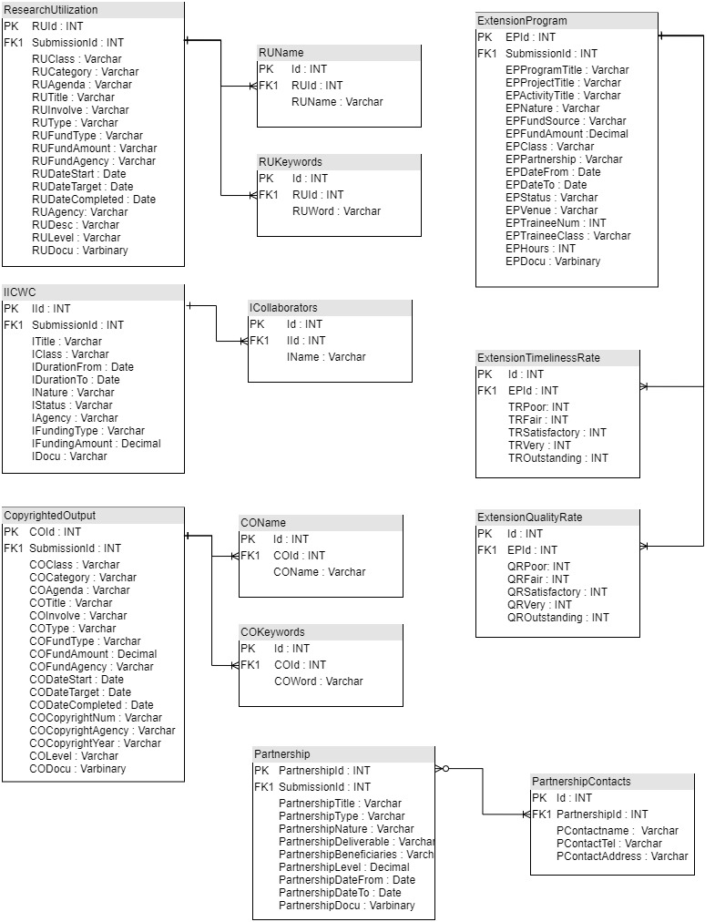
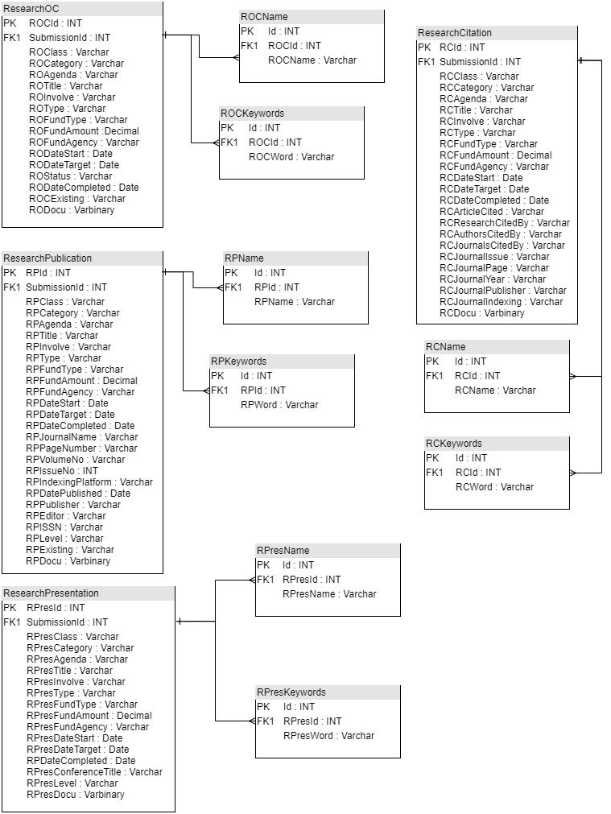

Slide 3
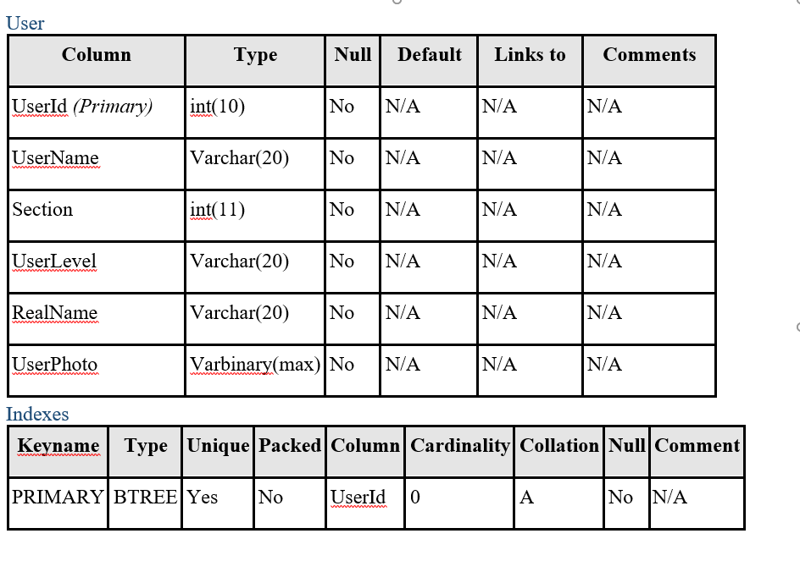
Data Dictionary
User Table

Slide 4
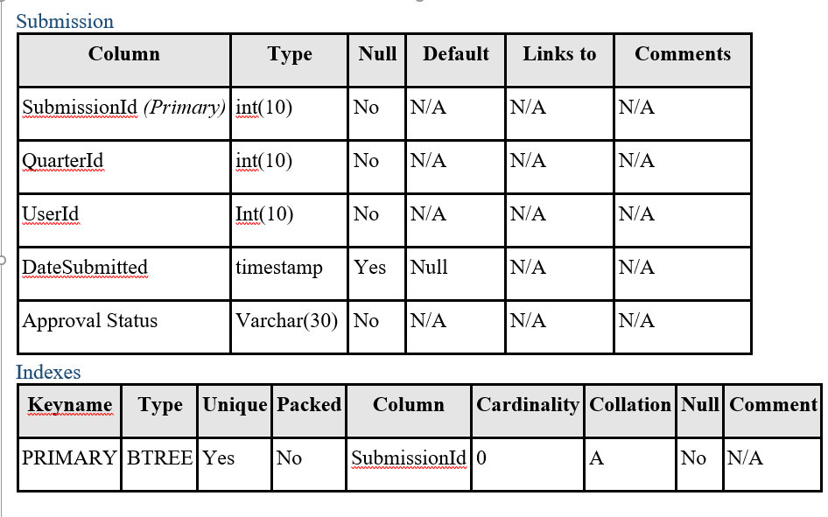
Submission Table

Slide 5
Data Dictionary
There are a total of 42 tables for the QAR Form in the system where there are 16 main tables and 16 sub tables
The main tables include:
OngoingStudy
Awards
Membership
AttendanceDP
AttendanceT
OPCR
OPCREfficiency
OPCRTimeliness
AttendanceU
ReqAndQue
SpecialTasks
ResearchOC
ResearchPublication
ResearchPresentation
ResearchCitation
ResearchUtilization
CopyrightedOutput
IICWC
EServiceRenderedConsultant
EServiceRenderedConference
ExtensionProgram
Partnership
InvolvementMobility
ViableDemo
AwardOrg
RelationAndProgram

Slide 6
Data Dictionary
The sub table include:
ROCName
ROCKeywords
RPName
RPKeywords
RPresName
RPresKeywords
RCName
RCKeywords
RUName
RUKeywords
COName
COKeywords
ICollaborators
ExtensionQualityRate
ExtensionTimelinessRate
PartnershipContacts

Slide 7
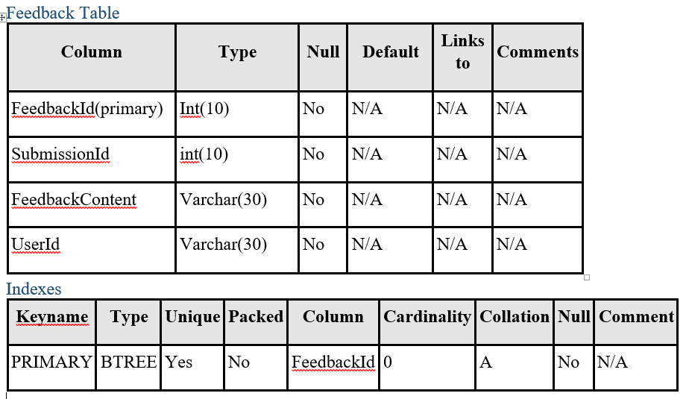
Feedback Table

Slide 8
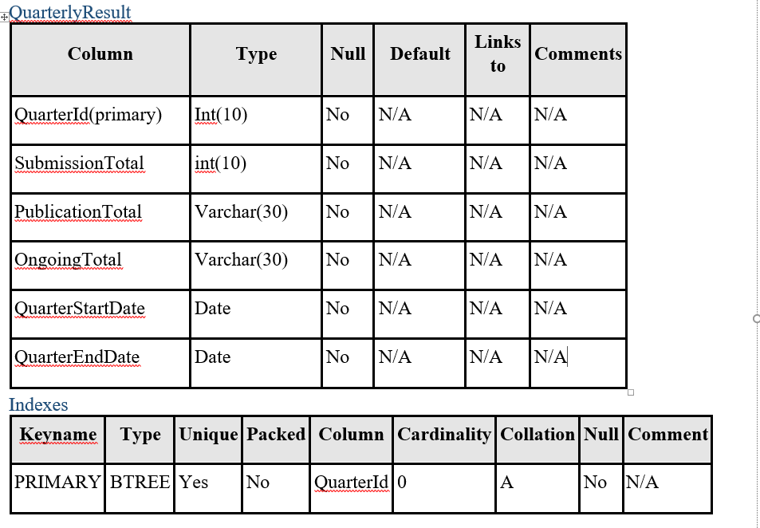
Feedback Table

Slide 9

GUI Design

Slide 10
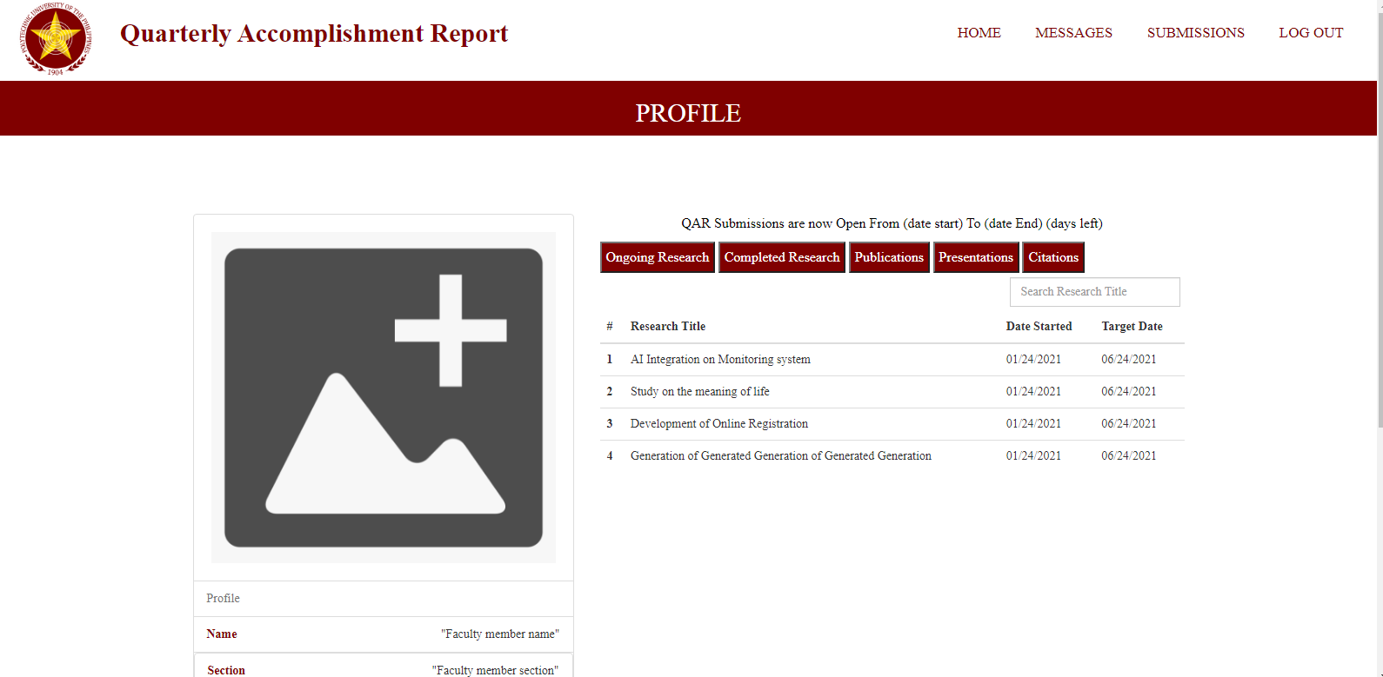
Faculty Members Account

Slide 11
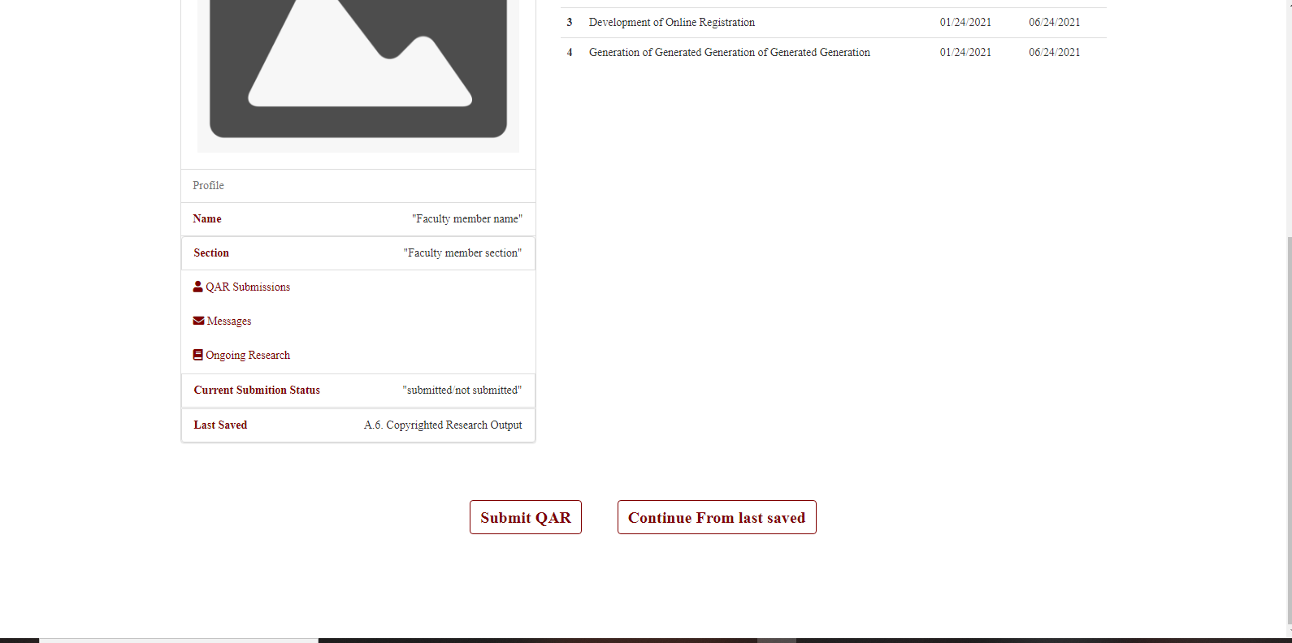
Faculty Members Account

Slide 12
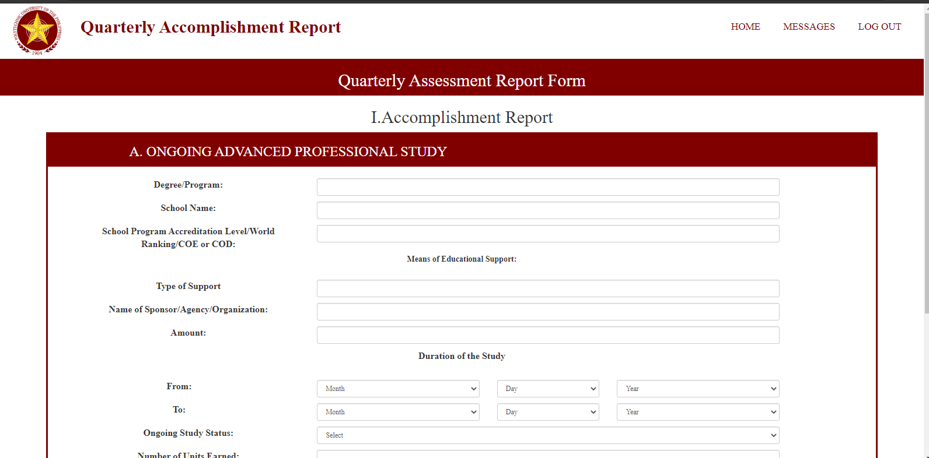
QAR Forms

Slide 13
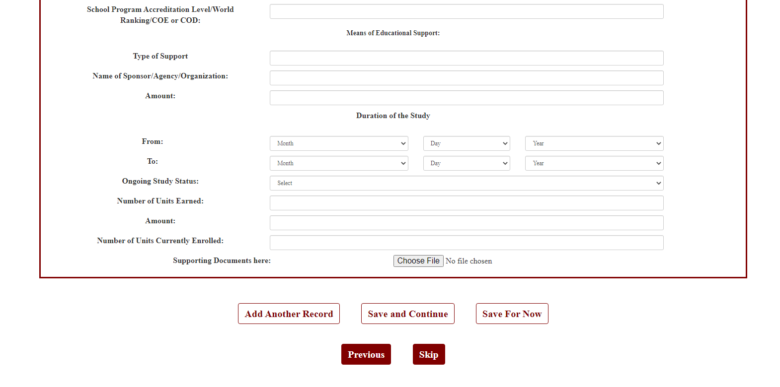

Slide 14
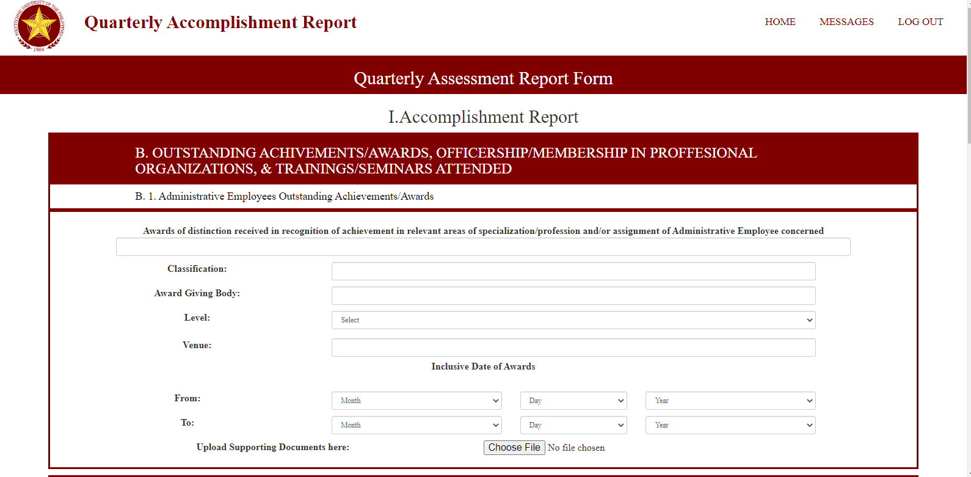

Slide 15
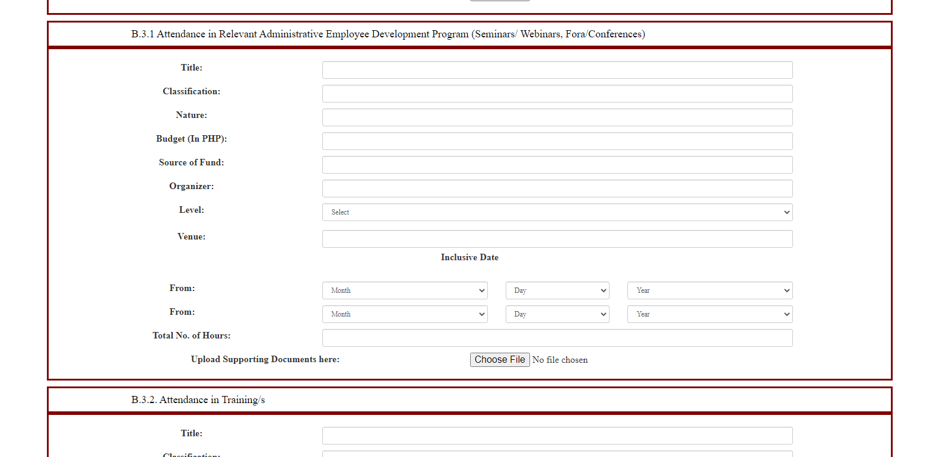

Slide 16
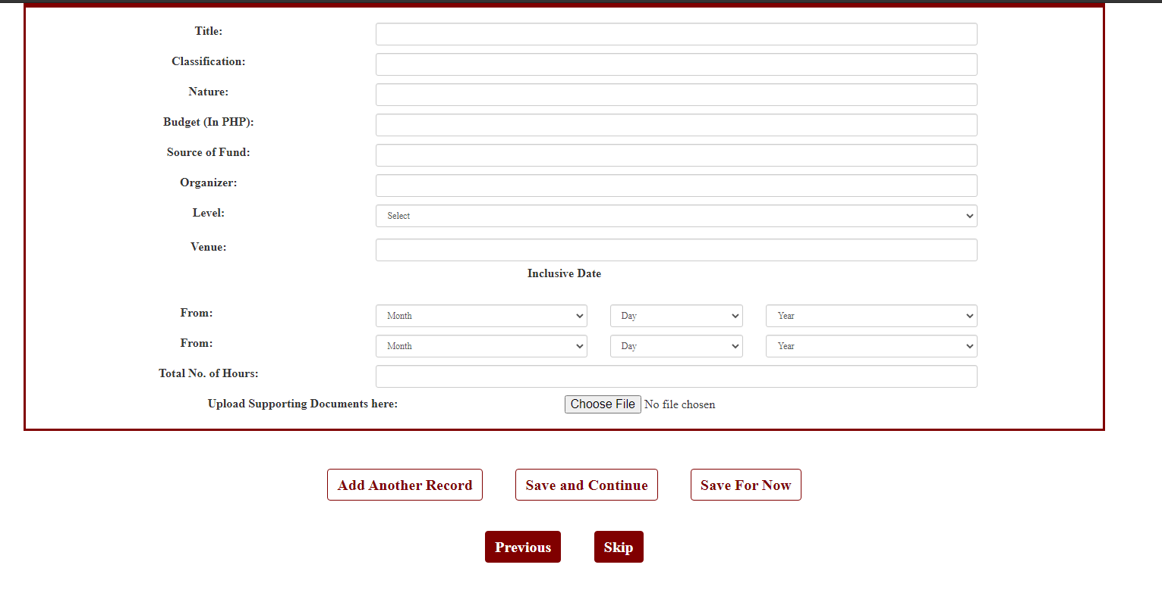

Slide 17
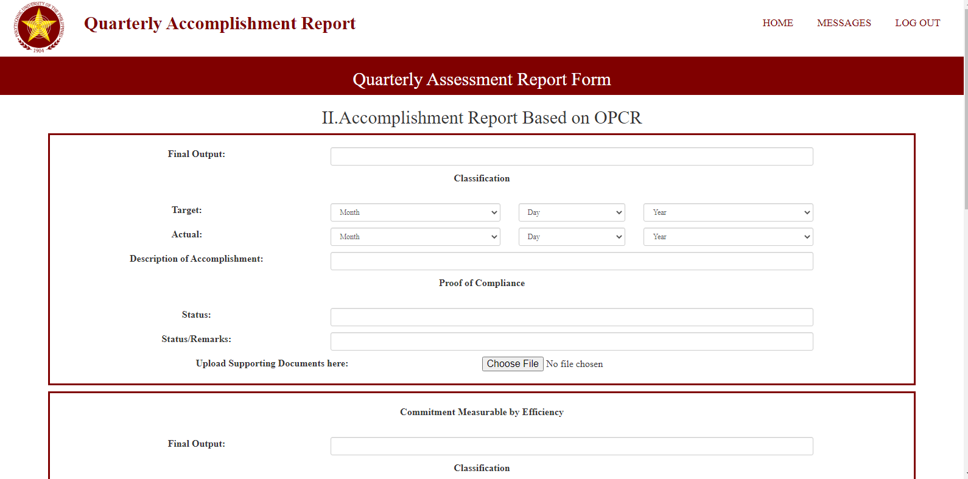

Slide 18
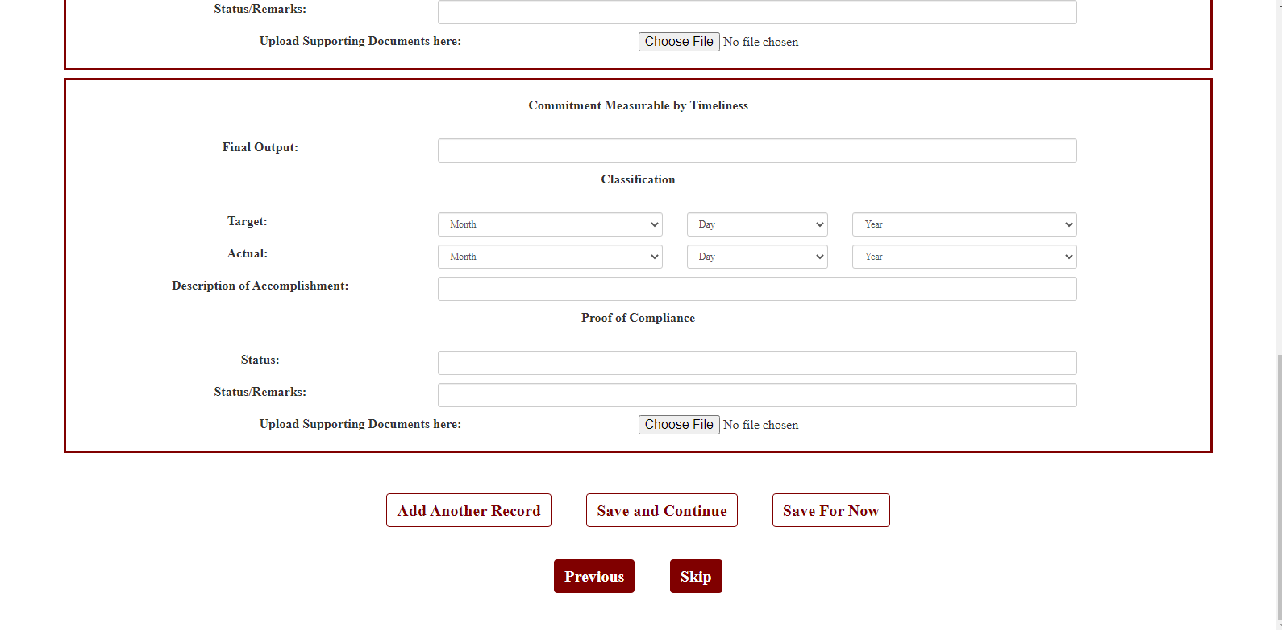

Slide 19
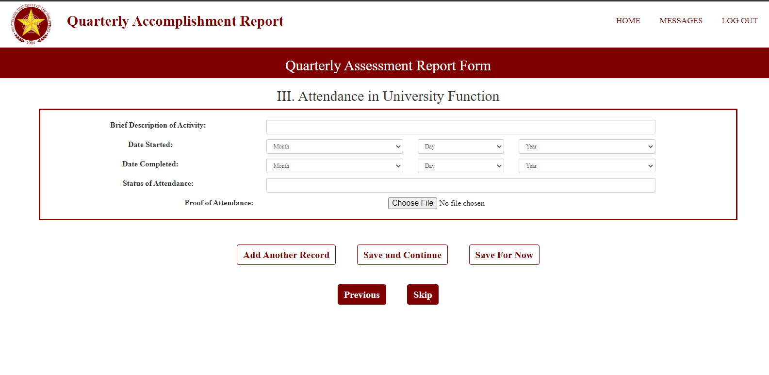

Slide 20
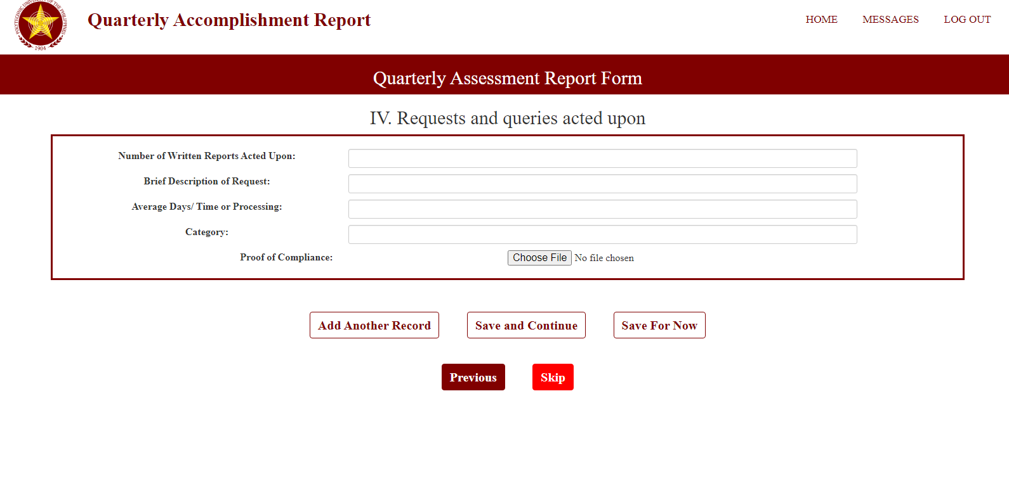

Slide 21
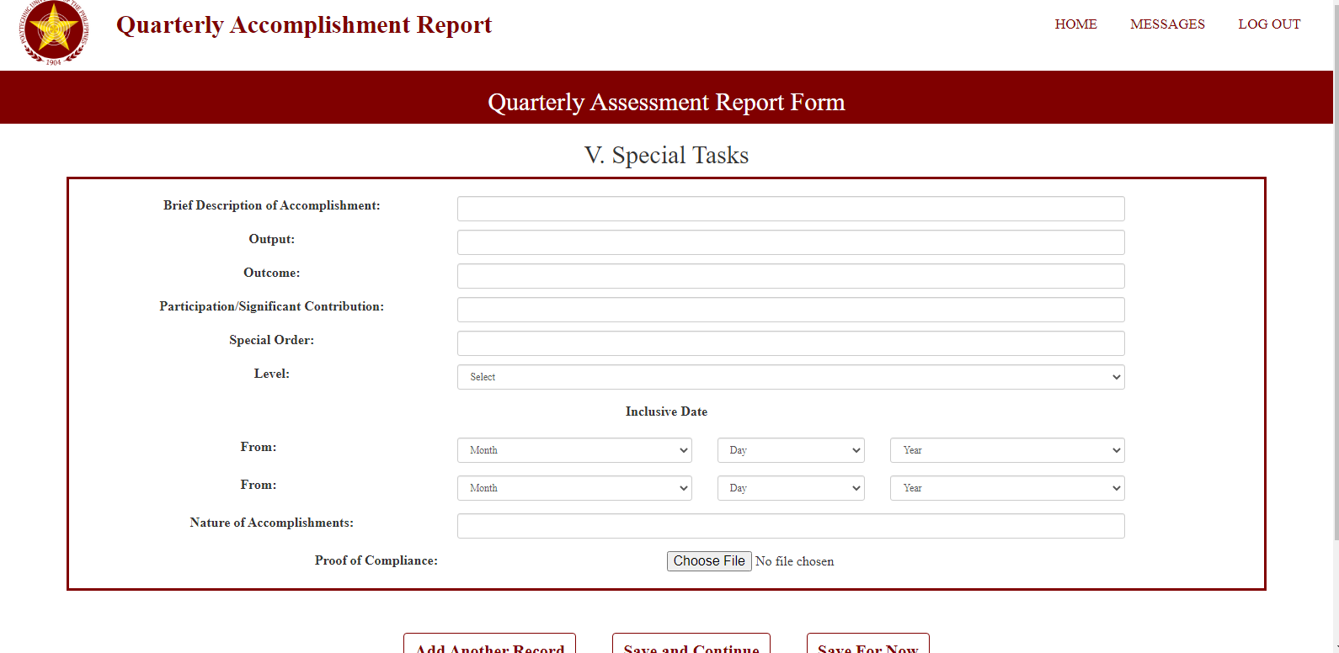

Slide 22
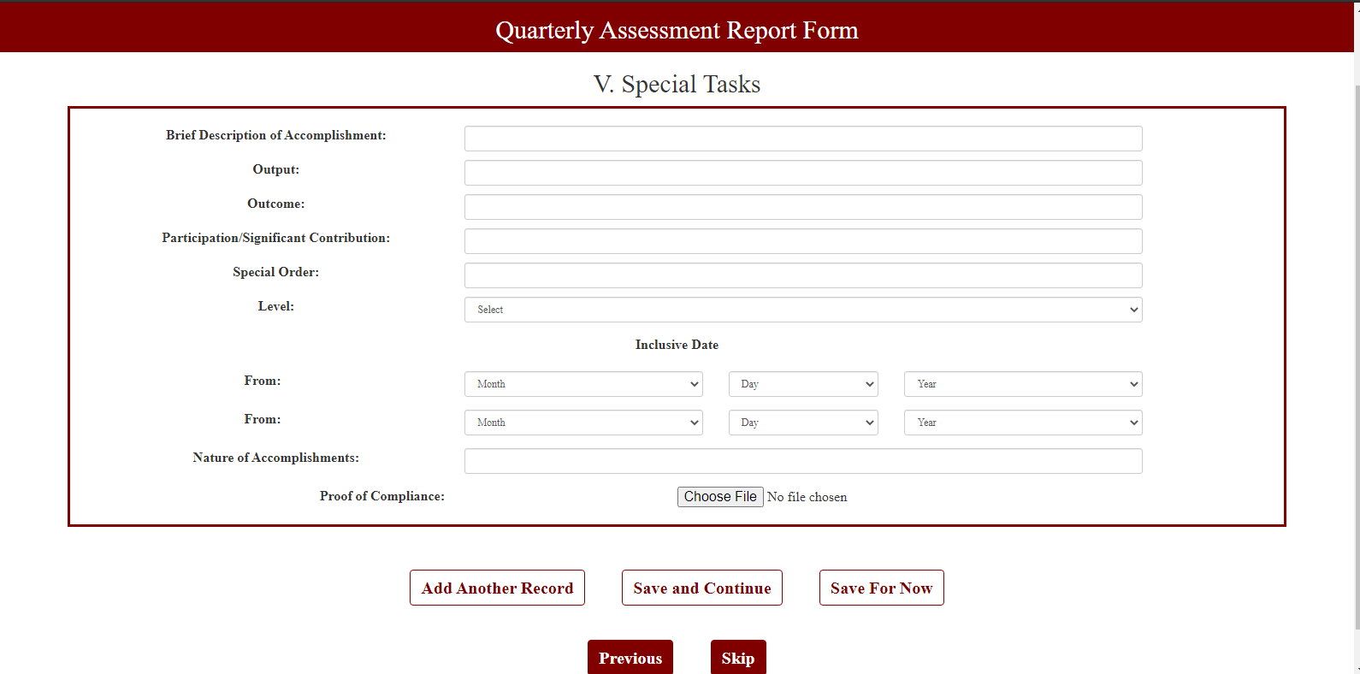

Slide 23
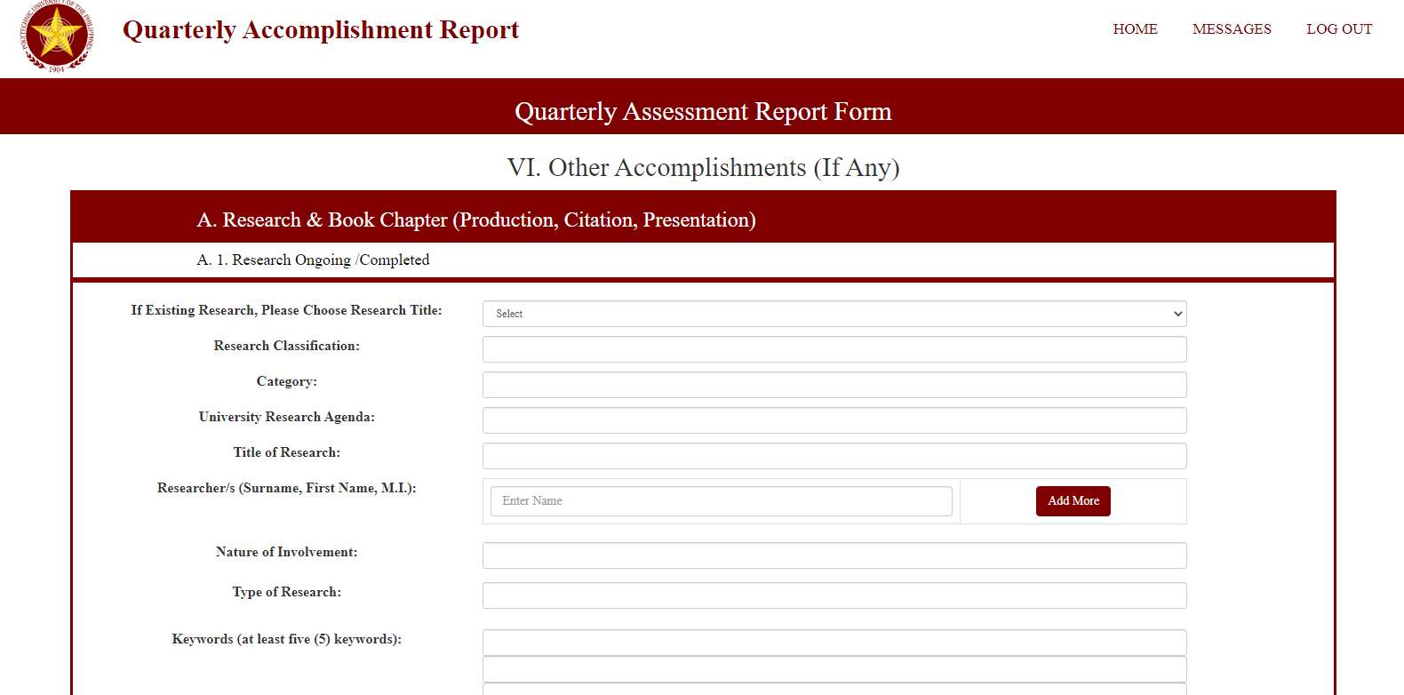

Slide 24
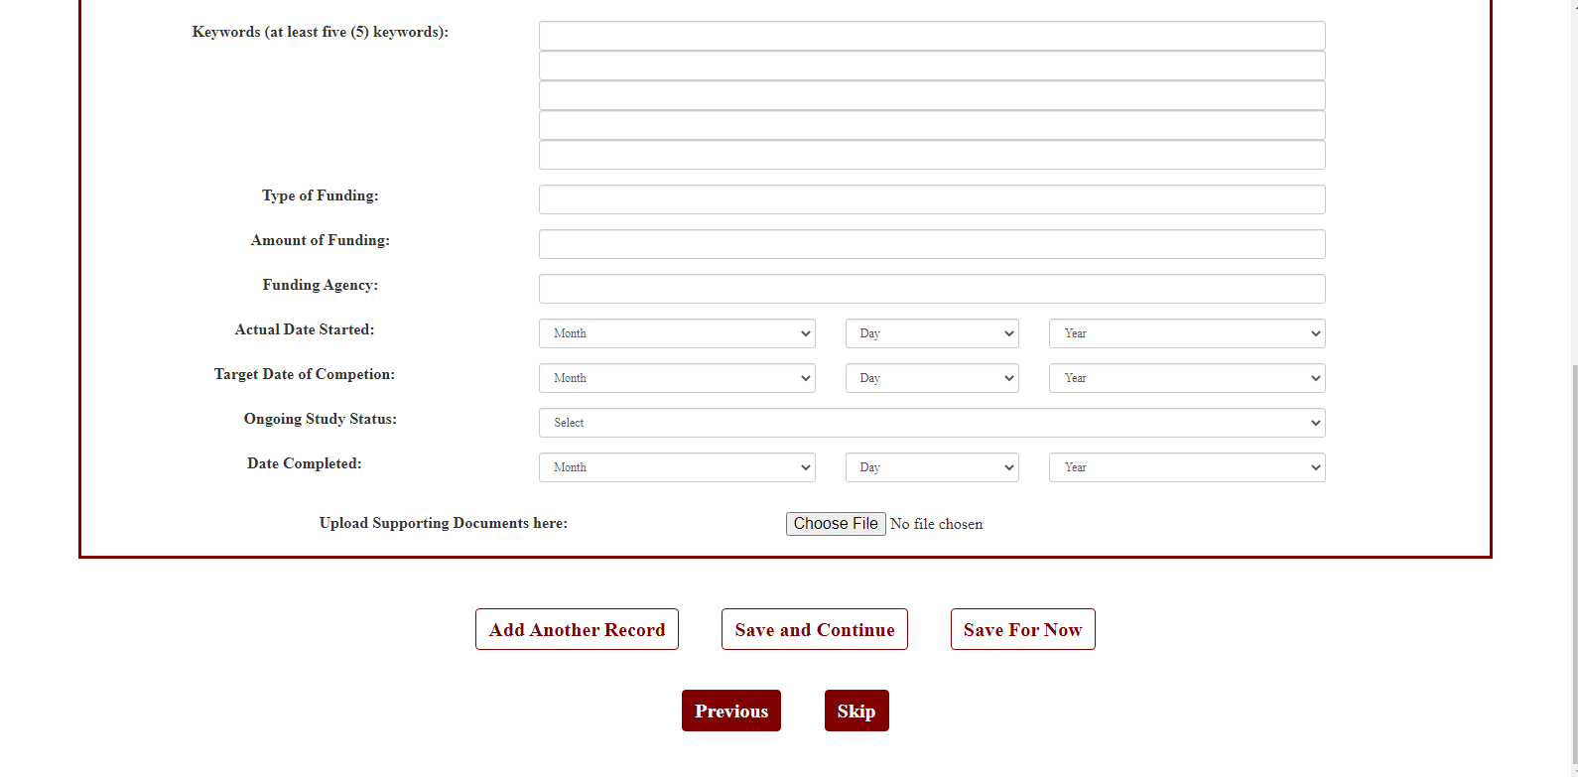

Slide 25
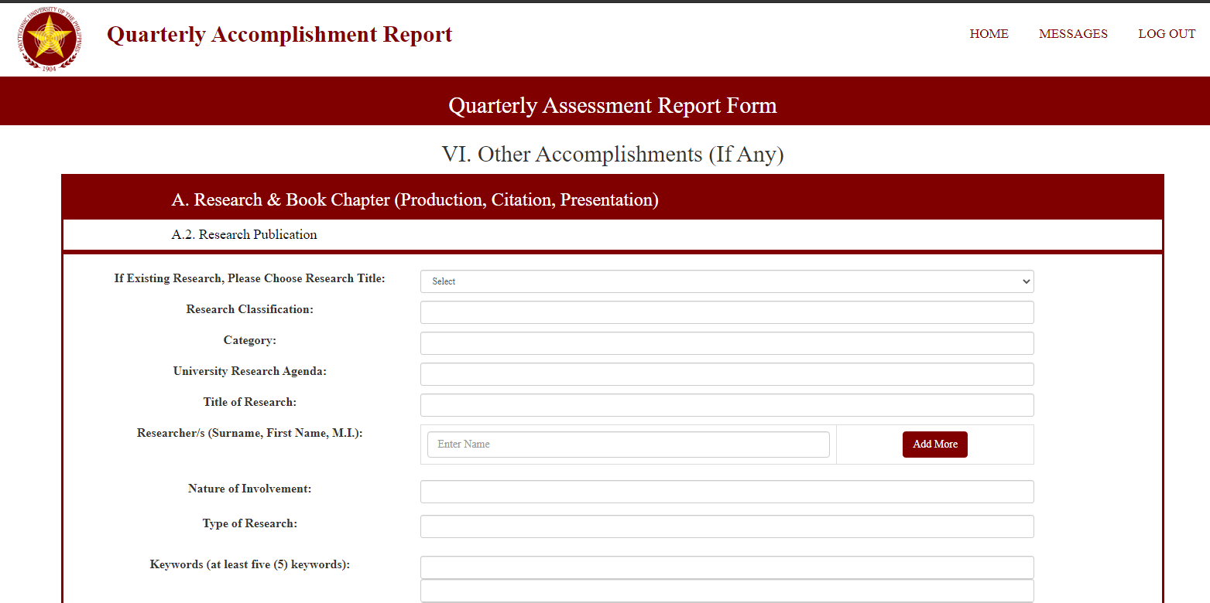

Slide 26
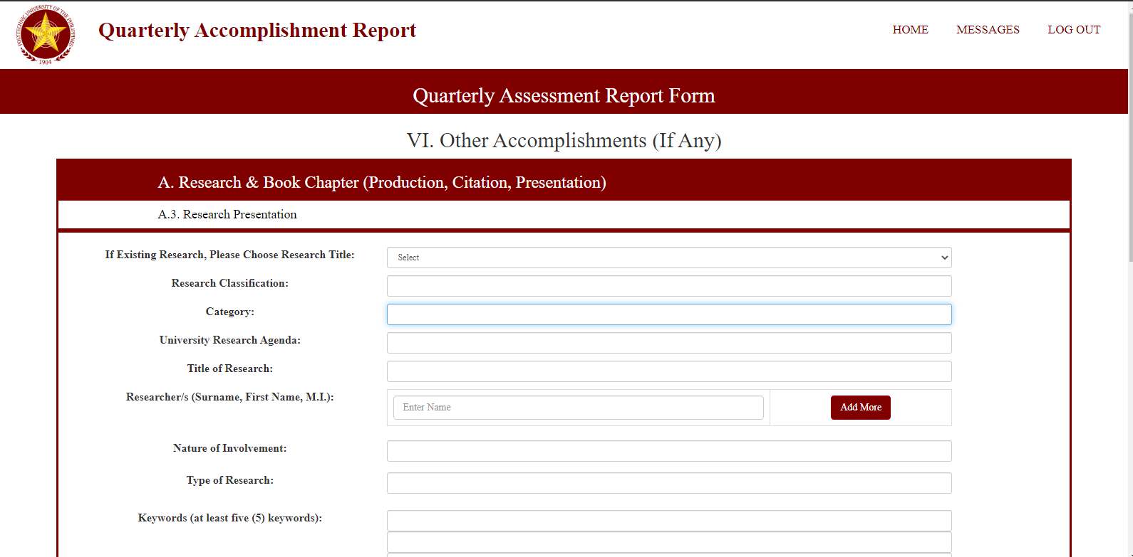

Slide 27
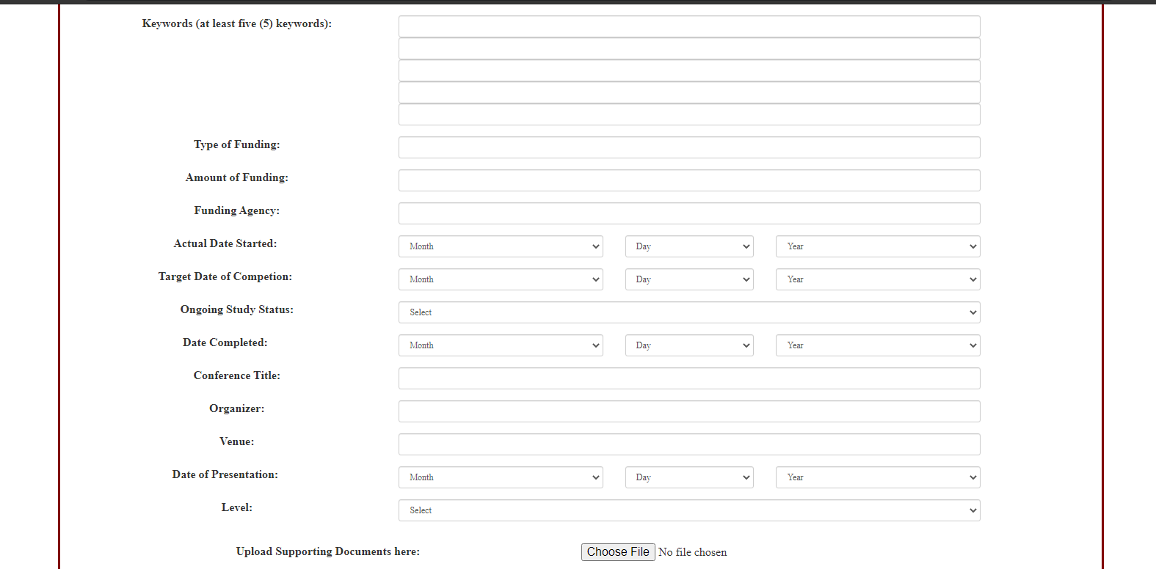

Slide 28
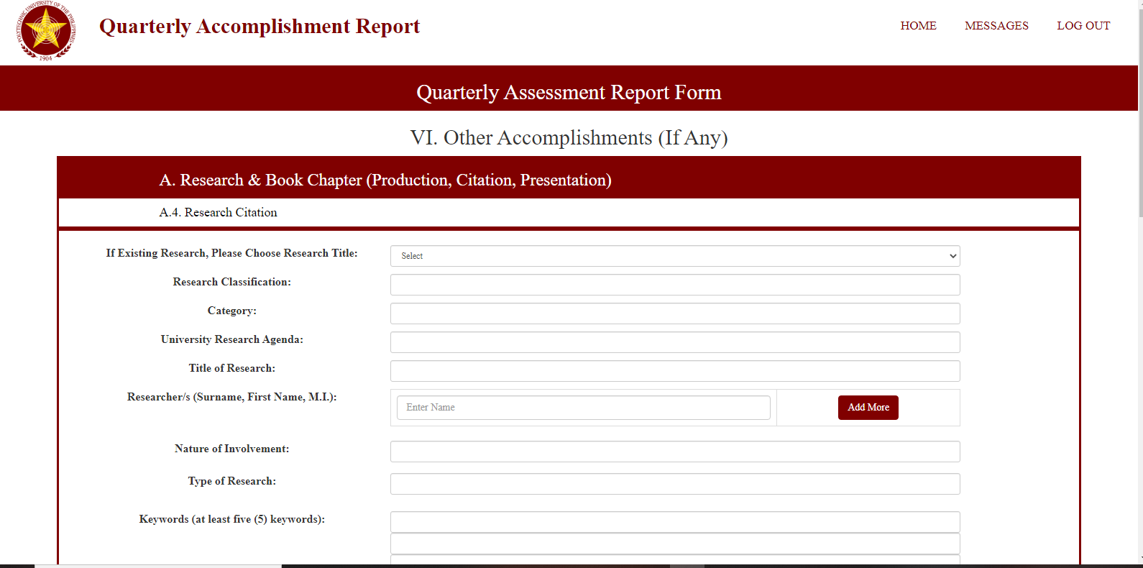

Slide 29
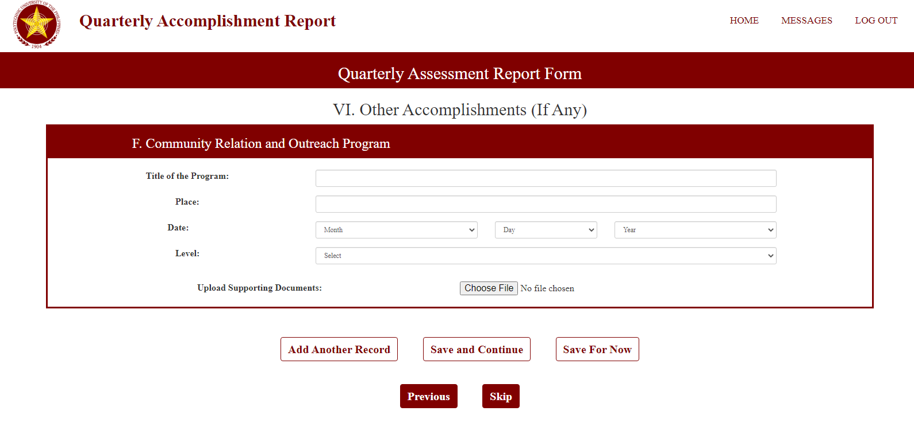

Slide 30
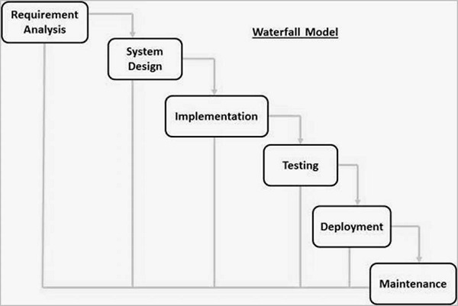
Development Methodology
Waterfall Method
Linear project management
Requirements are gathered and finalized at the beginning

Slide 31
Test Methodology
System Testing – This test will check if the system is functional in different browsers
Acceptance Testing - This test will ensure that the system meets the requirements of the client.
Functional Testing – This will show if the system output meets the requirements of the client
End-to-end Testing – This is to test the functionality and performance of an application under product-like circumstances to replicate live settings.

Slide 32
System Requirements
Hardware requirements
Hardware Component | Minimum Specification
Processor | Intel i3-2330 Processor 2.20 GHz
Installed Memory (RAM) | 4.00 GB
Hard Disk Drive | 500GB

Slide 33
System Requirements
Software Requirements
Software Component | Minimum Specification
Microsoft Windows 10 | 64-bit
XAMPP | 7.1.32-0 / 7.2.22-0 / 7.3.9-0

Slide 34
System Requirements
The suggested operating system is at least Windows 7 64-bit or higher.
To access the website, any updated browser can be used. Google Chrome is a highly suggested platform that ensures full interface functionality.
To be able to fully utilize the functions of the system, the clients are recommended to install the following:
PDF Viewer
Printer

